Slide 1
Dynamic Chess
Ryan, Mason, aristotle

Slide 2
Player roles/Game world
A player is given one a full set of chess pieces
Overall objective is to checkmate your opponent’s King
A player wins when they eliminate all of the opponents pieces on the board, triggering a win state

Slide 3
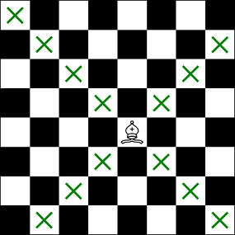
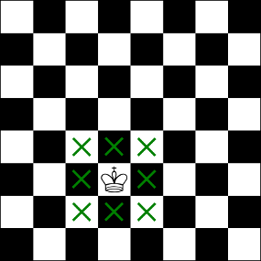
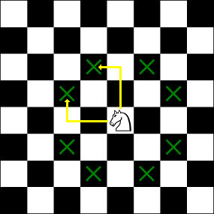
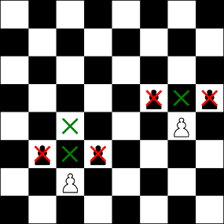
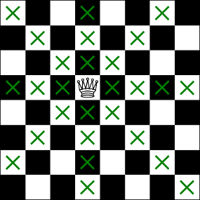
Game rules/characters
Each player is required to follow traditional chess rules for each piece
Each player has 1 king, 1 queen, 2 rooks, 2 bishops, 2 knights, and 8 pawns

Slide 4
What makes this different
The game board can dynamically changes per start-up
I.e. A board may be designed with 2 tiles off to the left rather than the standard square board
Part of the challenge is to chase the opponent’s pieces according to the tiles and the rules governed by each piece

Slide 5
Integration of ai
In our dynamic chess game, we created a point system which the AI uses to justify and execute moves.
We also decided to keep the computational time down to allow for a faster gaming experience (between 1ms and 1 frame computational timing).
Though the AI is quick, users can channeled into fast decisions compromising their chess pieces

Slide 6
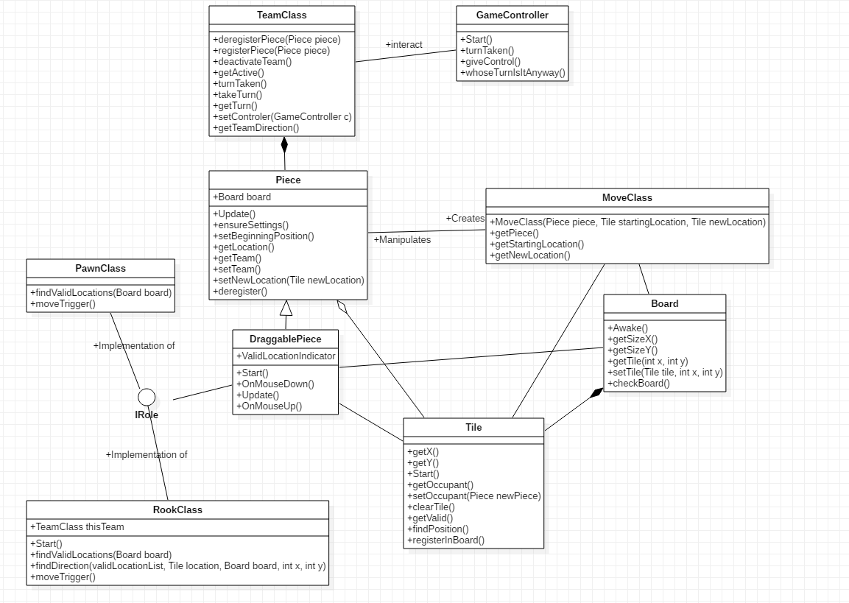
UML Diagram

